Slide 1
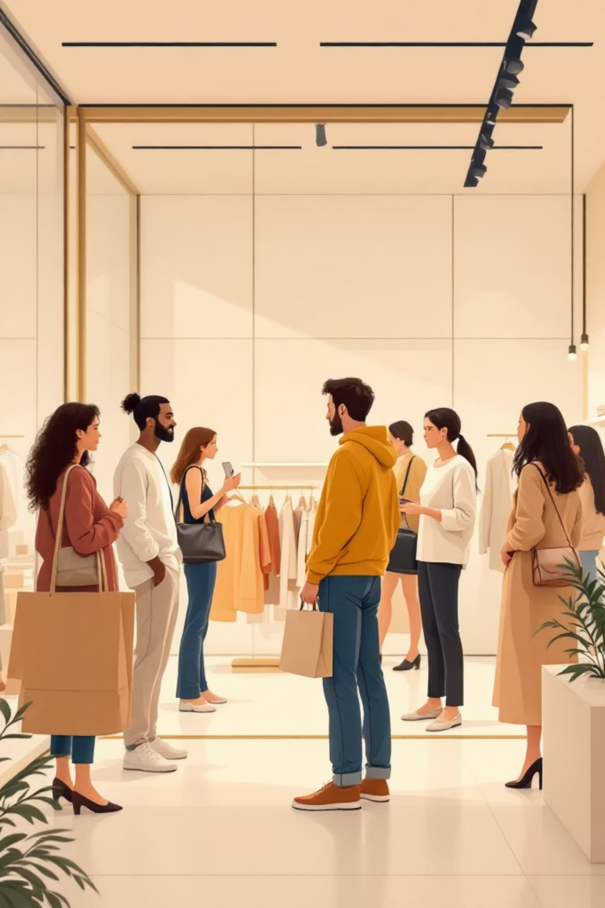
Customer Shopping Behavior Analysis
This presentation summarizes analysis of 3,900 transactional records to reveal spending patterns, customer segments, product preferences, subscription behavior, and actionable recommendations to guide strategic decisions.

Slide 2

Project Overview
This project analyzes customer shopping behavior using transactional data from 3,900 purchases across multiple product categories. The objective is to uncover insights into spending patterns, customer segments, product preferences, and subscription behavior to inform strategy and priority actions.

Slide 3
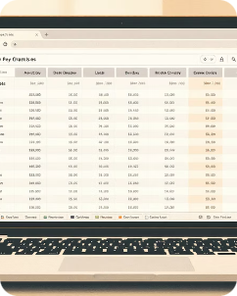

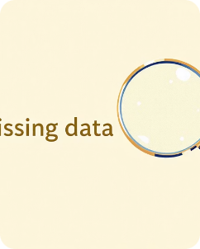
Dataset Summary
The dataset contains 3,900 rows and 18 columns including demographics (age, gender, location, subscription status), purchase details (item, category, amount, season, size, color), and behavior fields (discount applied, promo code, previous purchases, purchase frequency, review rating, shipping type). There are 37 missing values in the Review Rating column.
Rows & Columns
Key Features
Missing Data
3,900 rows × 18 columns
Demographics, purchase details, and shopping behavior fields
37 nulls in Review Rating; handled in preprocessing

Slide 4

Exploratory Data Analysis (Python)
Data preparation and cleaning steps in Python included: loading with pandas, initial exploration via df.info() and describe(), median imputation for missing review ratings by product category, and renaming columns to snake_case for clarity.
Feature Engineering
Redundancy Check
Database Integration
Created age_group bins and purchase_frequency_days from timestamps.
Verified discount_applied vs promo_code_used; dropped promo_code_used as redundant.
Loaded cleaned DataFrame into PostgreSQL for SQL analysis.

Slide 5
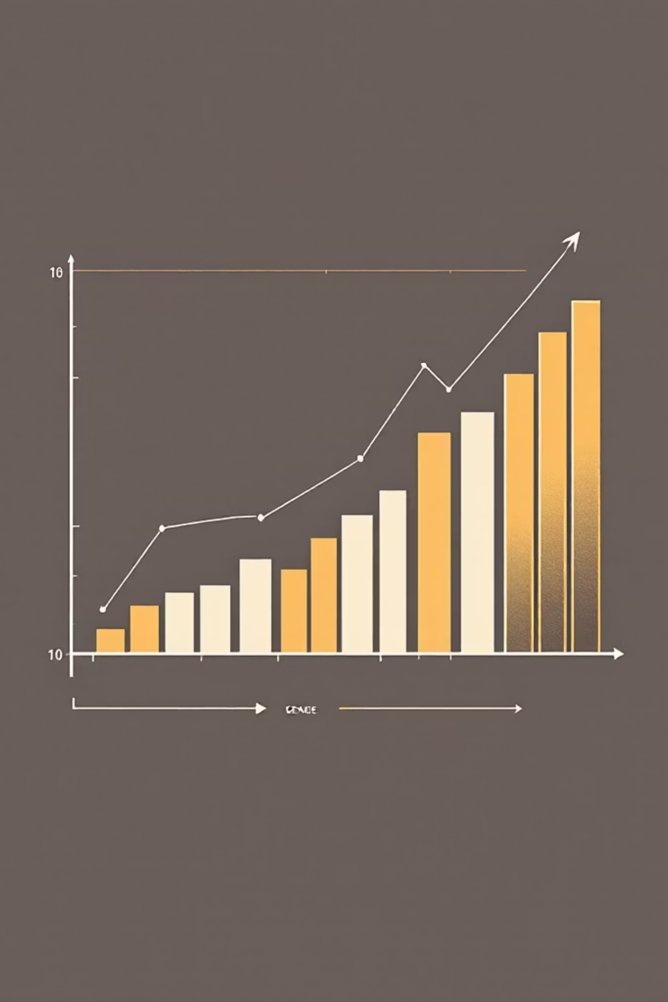
Revenue & Gender Insights (SQL)
Comparative revenue by gender shows Male customers generated $157,890 and Female customers generated $75,191. This sizable gap suggests differences in purchase frequency, basket size, or product mix that warrant targeted study.

Slide 6


High-Spending Discount Users & Top-Rated Products
SQL identified 839 rows of discount users who still spent above average—examples include customers with purchases of 64, 73, 90 USD, and more. Top 5 products by average rating: Gloves (3.86), Sandals (3.84), Boots (3.82), Hat (3.80), Skirt (3.78).
Discount & Spend
Top Rated Items
Many customers use discounts yet maintain above-average purchase amounts—opportunity to tailor promotions.
Highlight these in campaigns and merchandising to leverage social proof and lift conversions.

Slide 7

Shipping, Subscriptions & Repeat Buyers
Average purchase amounts: Standard shipping = $58.46, Express = $60.48. Subscribers: 1,053 customers, avg spend $59.49, total revenue $62,645. Non-subscribers: 2,847 customers, avg spend $59.87, total revenue $170,436. Repeat buyers (>5 purchases) are more often non-subscribers (2,518 No vs. 958 Yes).
Standard
Both
Express
Avg purchase $58.46
Shared shoppers & habits
Avg purchase $60.48
The small difference in spend by shipping type suggests express-shipping users marginally spend more—consider targeted offers for higher-margin shipping tiers.

Slide 8




Customer Segmentation & Top Products by Category
Segmentation: Loyal = 3,116 customers, Returning = 701, New = 83. Top products per category include Jewelry, Sunglasses, Belt (Accessories); Blouse, Pants, Shirt (Clothing); Sandals, Shoes, Sneakers (Footwear); Jacket, Coat (Outerwear). Use product-level momentum to inform assortment and inventory decisions.

Slide 9
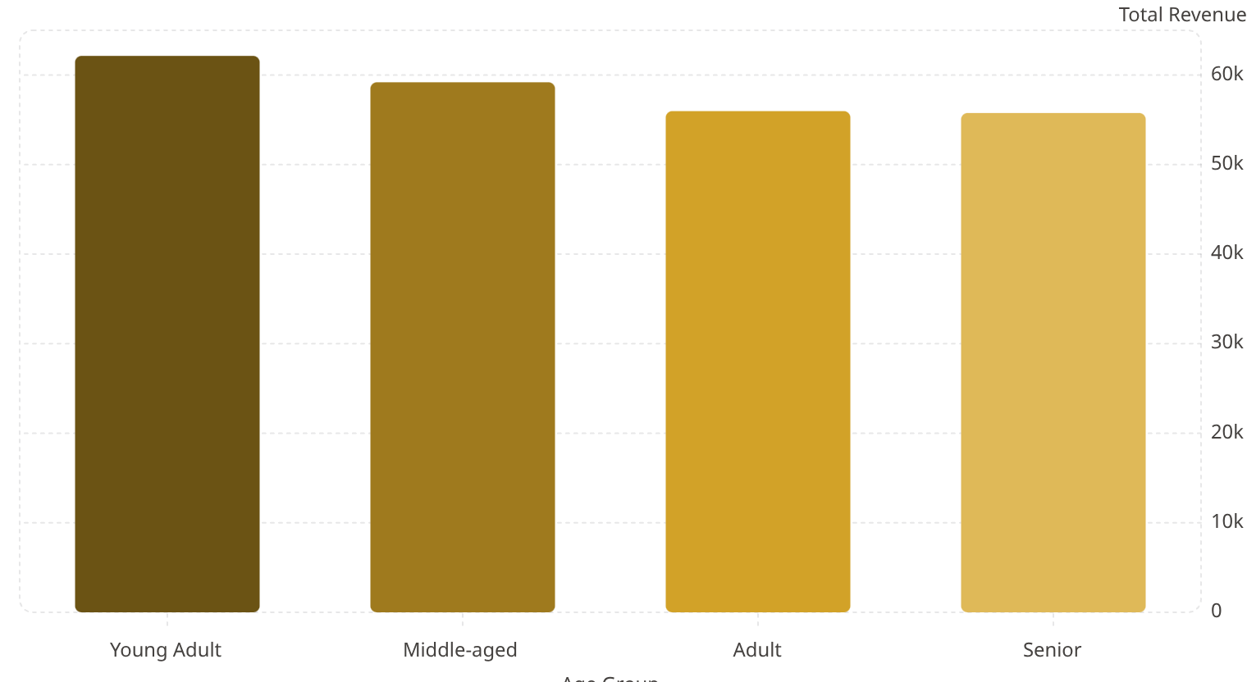
Revenue by Age Group & Key Metrics
Revenue contribution by age group: Young Adult $62,143; Middle-aged $59,197; Adult $55,978; Senior $55,763. Key dataset metrics: 3,900 customers, average review rating 3.75, average purchase amount $59.76. These groups are high-value targets for focused marketing and personalized experiences.

Slide 10
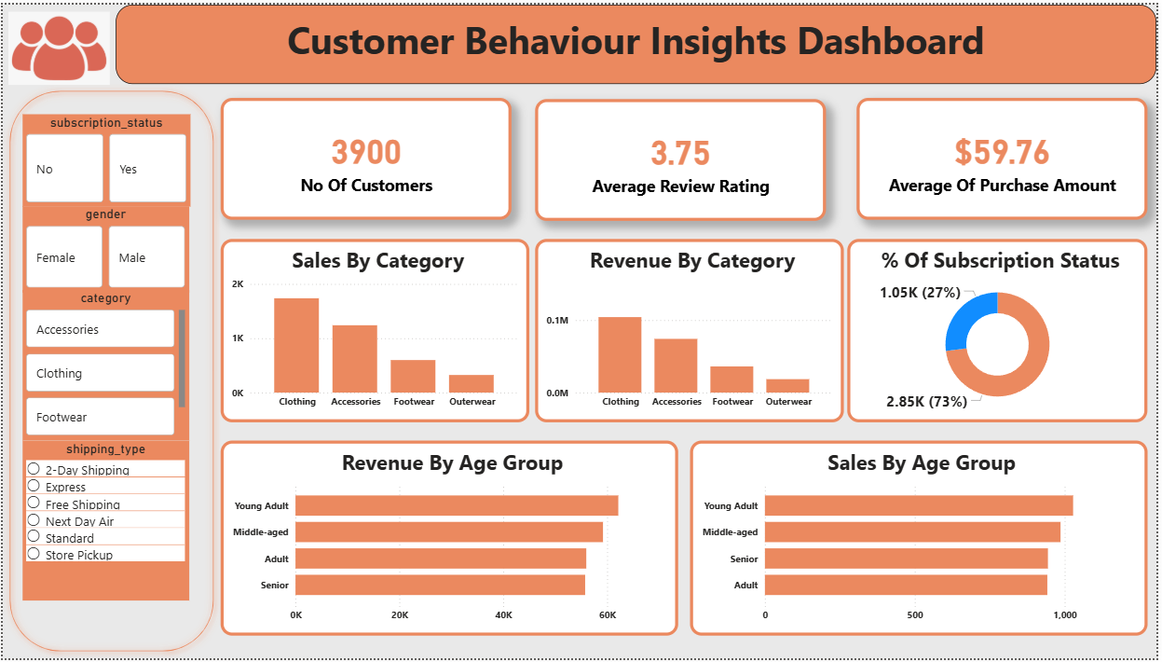
Dashboard & Business Recommendations
Boost Subscriptions
Customer Loyalty Programs
Review Discount Policy
Product Positioning
Promote exclusive benefits and targeted offers to increase subscriber conversion and recurring revenue.
Balance promotional activity with margin control—prioritize discounts on high-margin or high-conversion SKUs.
Feature top-rated and best-selling items (Gloves, Sandals, Blouse, Jacket) in campaigns and homepage merchandising.
Reward repeat buyers to move them into the Loyal segment and increase lifetime value.
Targeted Marketing
Focus on high-revenue age groups and express-shipping customers with personalized creatives and offers.
Next steps: refine segmentation models, A/B test subscription incentives, and operationalize dashboard KPIs for weekly monitoring.

